Slide 1

Artificial Intelligence Approach in Retail Market Analysis and Growth <Final Sprint>
Group: 6 Supervisor
Ankit Ramrakhyani (029371899) Dr. Mahshid Fardadi
Aparna Popade (026735460)
Sarthak Jariwala (029341388)
Shruthi Venkatchalam (029395663)
Devansh Goel (029362552)

Slide 2
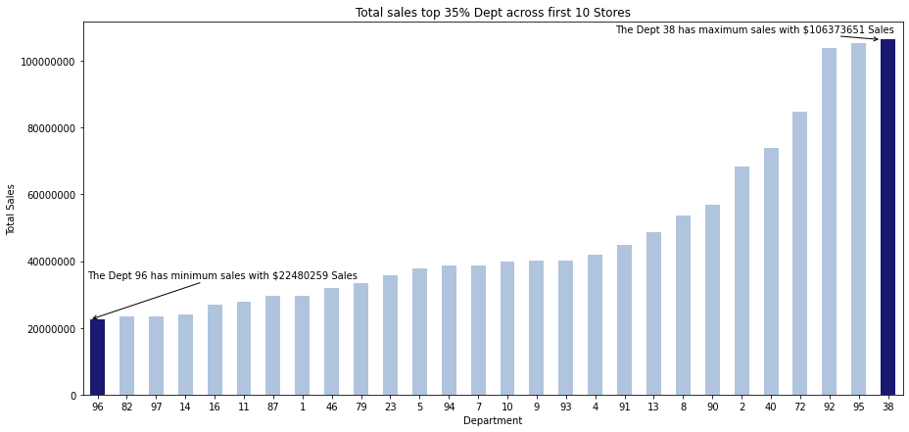
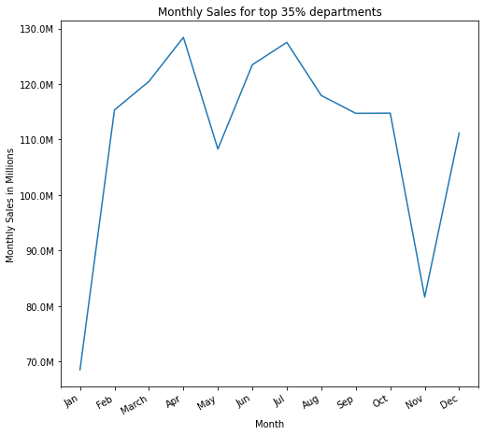
Sprint 01: Dataset 1
From the visual output that can be seen above, we can infer that the sales were high in month of March because of spring break and low in Jan considering holidays already over
This graph, indicates that the Dept 96 has very less sales with $22480259 whereas Dept 38 has maximum sales with $106373651.

Slide 3
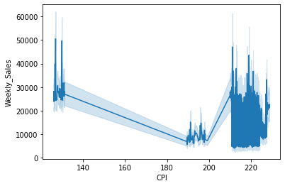
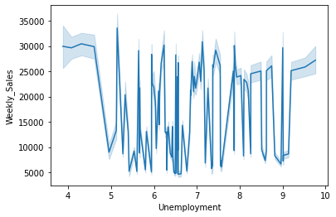
Sprint 01: Dataset 1
There is a moderate level of concentration of weekly sales in the early points of the CPI. However, the concentration of points goes way higher between 200 and 220 and around 220 CPI.
The graph starts off at 30000 weekly sales with around 4 unemployment.
Contradictory to this, there were nearly 5000 sales with 6 to 7 unemployment factors.

Slide 4
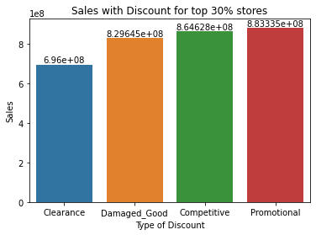
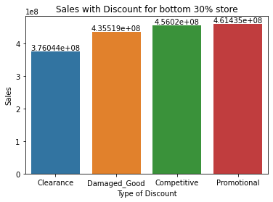
Sprint 01: Dataset 1
In Comparison to all the discounts given for top 30 percent Stores, sales are seen to be maximum when Promotional Discounts are given.
Similar to the previous result, it can be seen here that Promotion Discounts perform way better in terms of sale in comparison to other sorts of discounts..

Slide 5
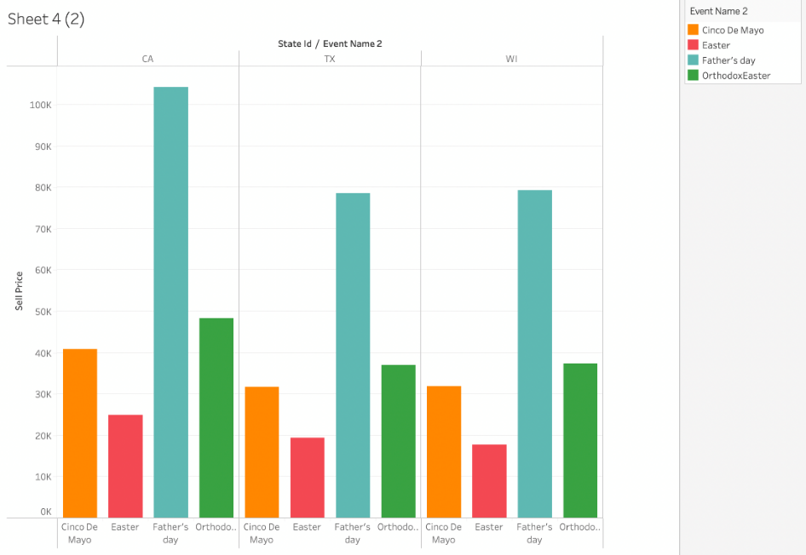
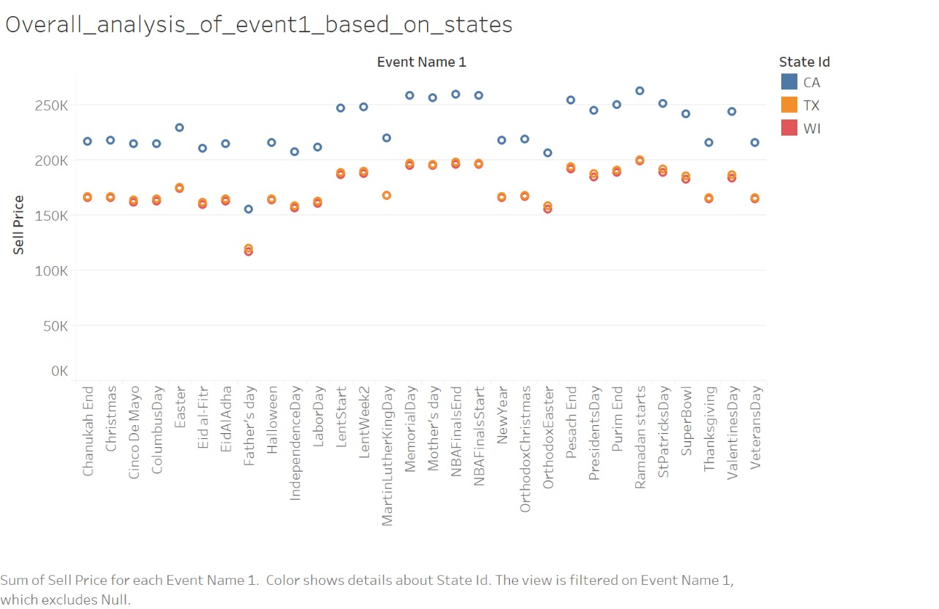
Sprint 01: Dataset 2
It is clear from the graph that the selling price for each day in the Event Name 1 in 3 States (California, Texas, and Wisconsin) are almost always above 150K with the selling price for the state of California almost always above 200K. It can also be seen that. The selling price for Texas and Wisconsin are nearly the same.
California has the highest selling price on Father's Day. Overall easter has lowest number of selling price in all the states.

Slide 6
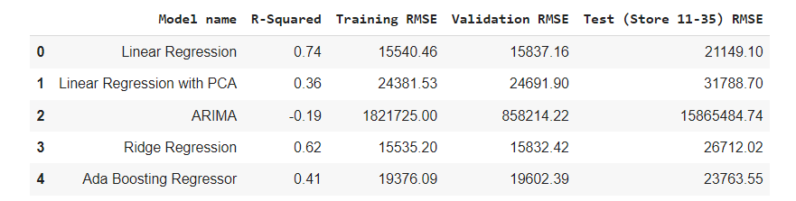
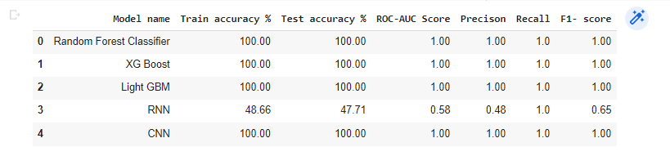
Sprint 02: Dataset 1
Performance of linear regression is better because properties of the linear-regression models are well understood and can be trained quickly.
Ensemble models performs better as compared to neural network model as neural network models are non-linear and have a high variance.

Slide 7
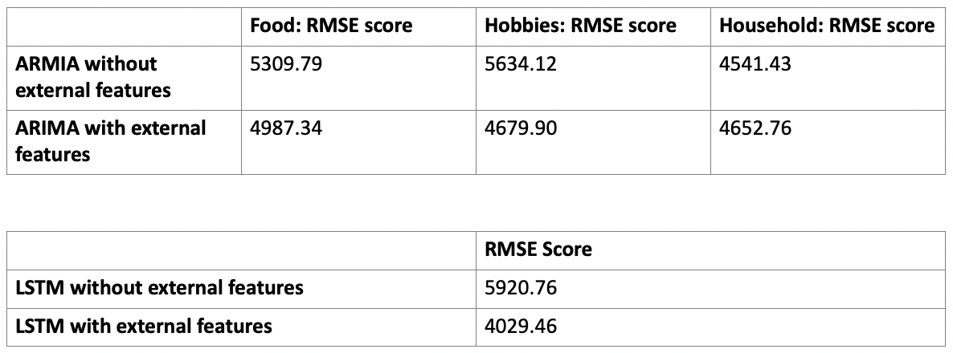
Sprint 02: Dataset 2
The ARIMA prediction without external features is not stationary due to its high value of test statistics.
The ARIMA prediction with external features is 99% stationary due to its low value of test statistics.

Slide 8
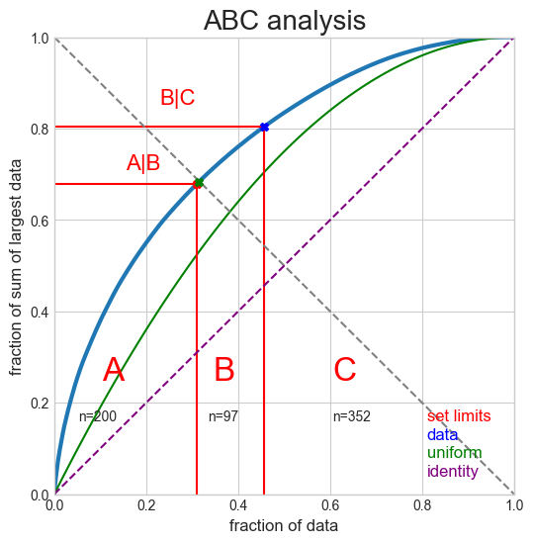
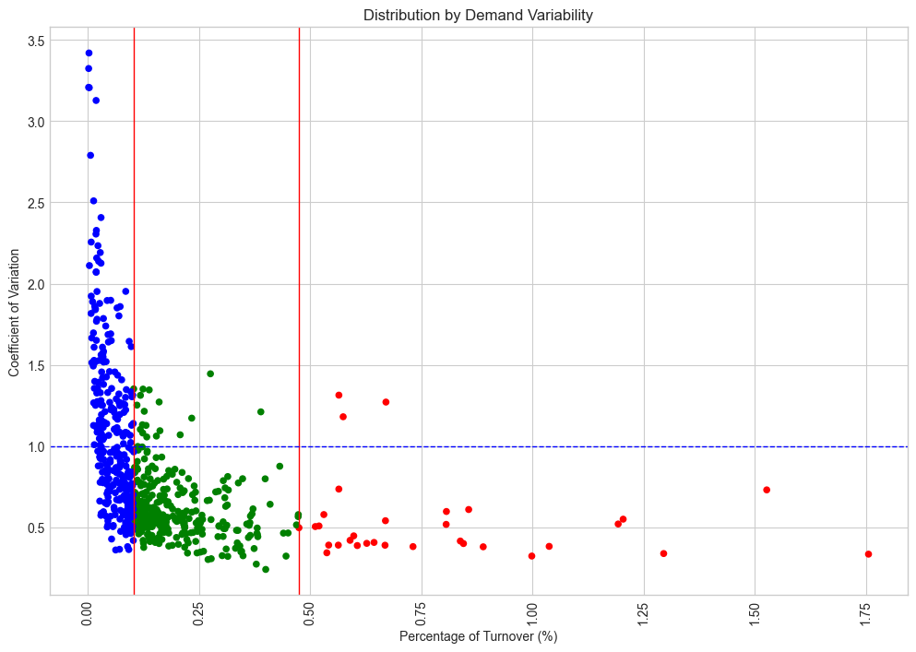
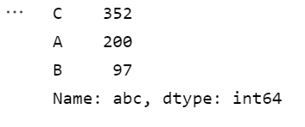
Sprint 03: Dataset 2 – Task A & B
A scatter graph plotting Coefficient of Variation against Percentage of Turnover (%)
ABC Analysis graph plot
Coefficient of Variation

Slide 9
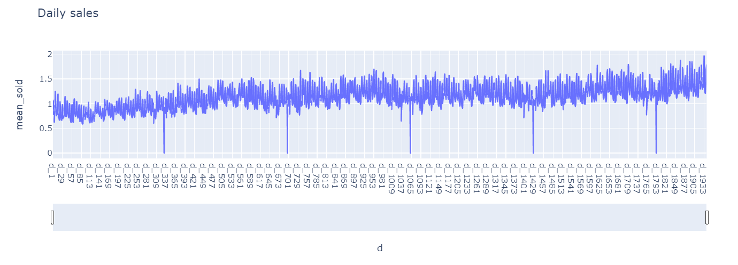
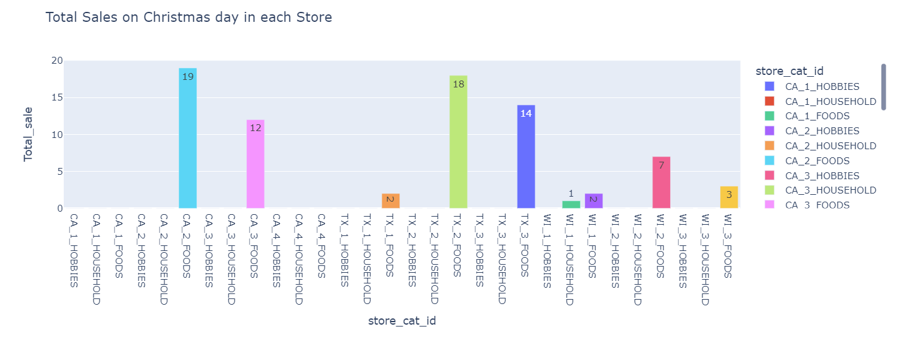
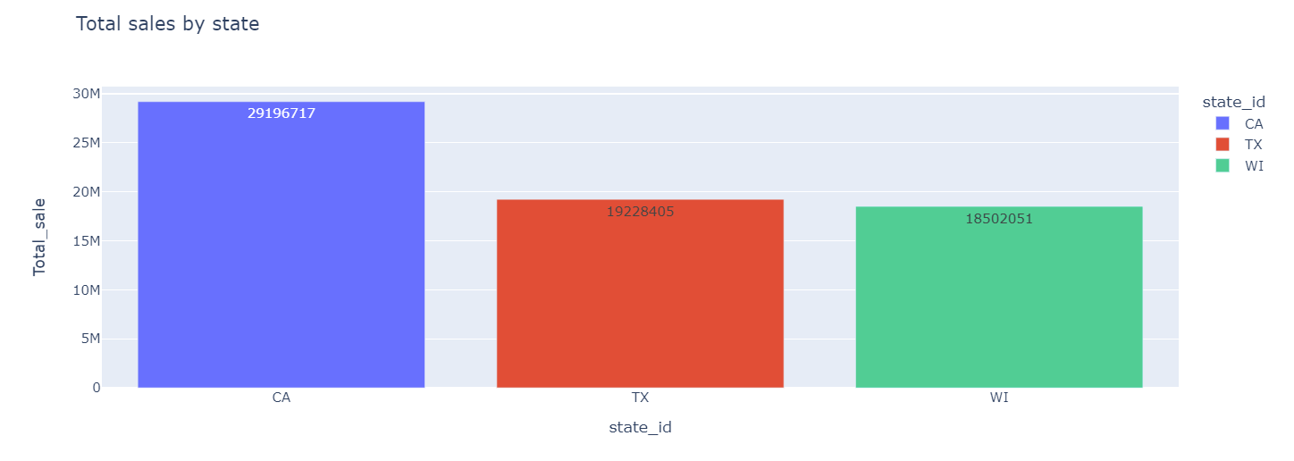
Sprint 03: Dataset 2 – Task C
Plotted graph of mean_sold against the multiple days' ids
It can be inferred here that on certain days sales drastically drop down to almost zero, and coincidentally we can also see that it is Christmas on those days.
Bar graph of the Total sales on the day of Christmas in each store in each product category.
As we can see that at Christmas the store wise sales by each category is zero except for food with CA_2 being the highest and Wi_1 being the lowest
Bar graph of the total sales in each state
Here it can be seen that California has the highest sales followed by Texas and then at last Wisconsin. The main reason being the fact that California has the highest population

Slide 10
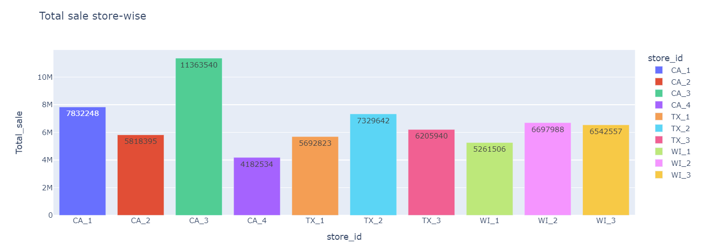
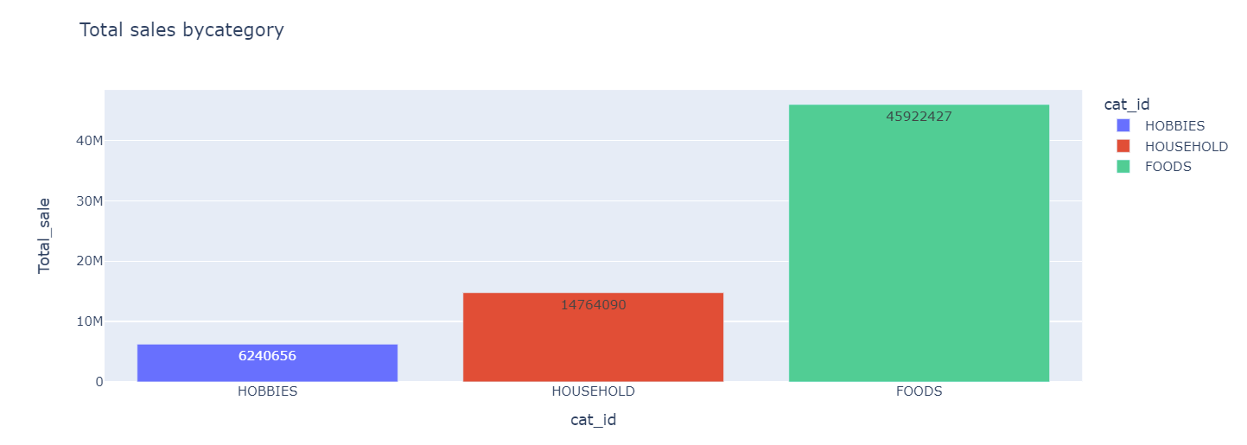
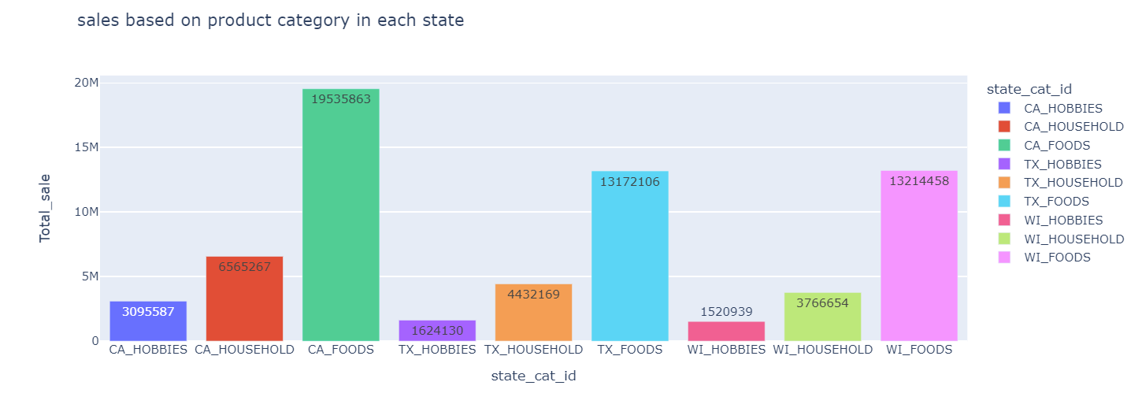
Sprint 03: Dataset 2 – Task C
Bar graph of the sales of stores in each state
As we can see that CA_3 has the highest sales among all other stores whereas CA_4 is the lowest in terms of sales.
Bar graph of sales by category (Hobbies, Households, Foods)
It is very evident from the graph above that Food items are the highest selling products. However, Hobbies related products are the lowest with respect to selling
Bar graph of the Sales divided based on product category in each state
Overall, food items are sold more than anything else across all the three states.

Slide 11
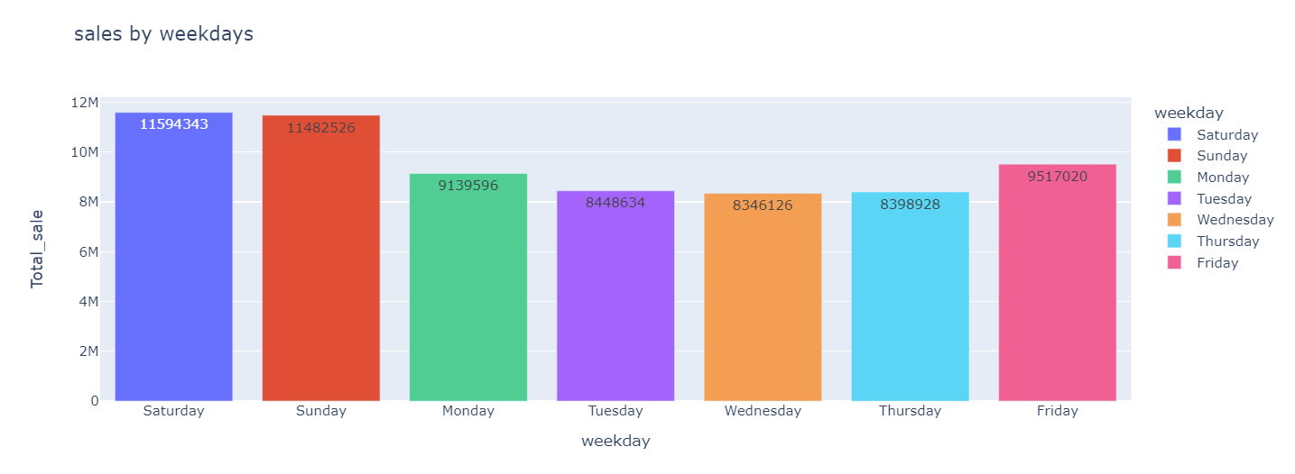
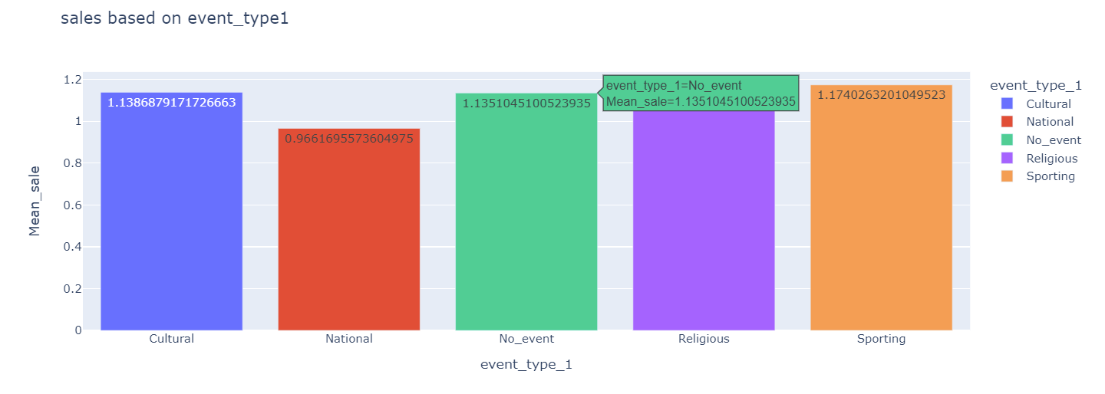
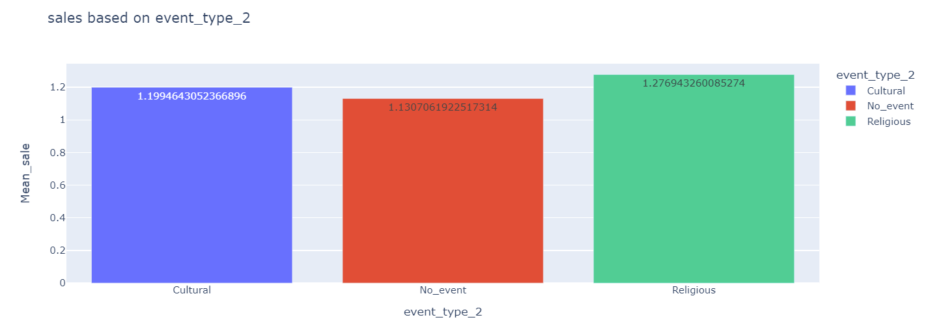
Sprint 03: Dataset 2
Bar graph of the sales of the stores by the weekdays.
It’s clear from the graph above that Fridays, Saturdays and Sundays have sales when compared to other days of the week.
Bar graph based on the categories of the event types
We can see that the sales are less on national holidays.
Bar graph based on the categories of the event types
religious events affect the sales of products.

Slide 12
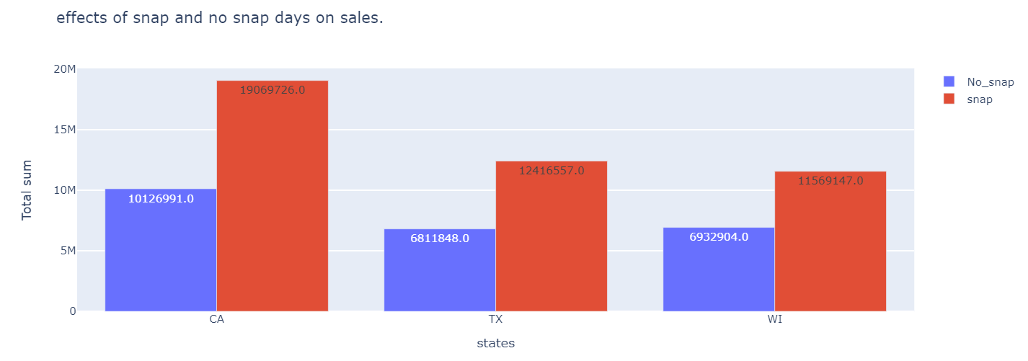
Sprint 03: Dataset 2
Bar graph representing the effects of the snap or no snap days on sales
Snap days have higher sales as compared to non-snap days across all the states.

Slide 13
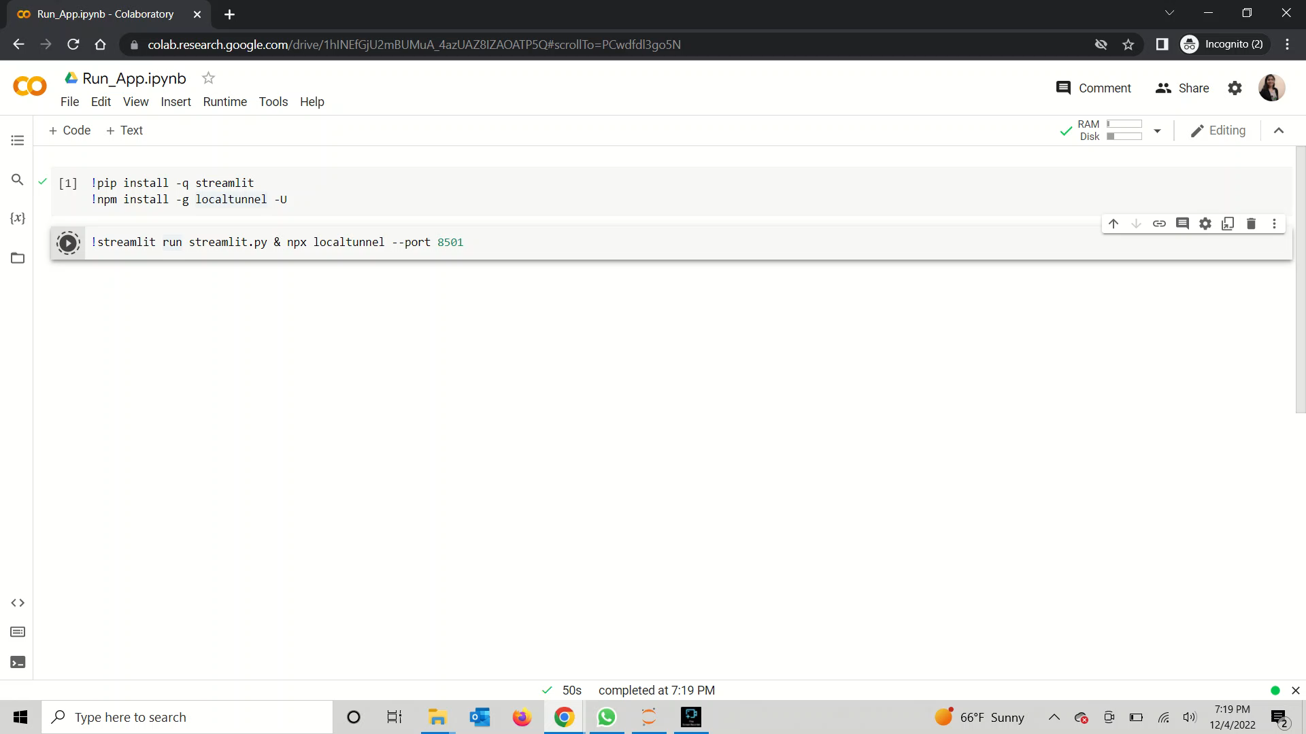
Streamlit Deployment Demo:

Slide 14
Code Links:
Dataset 1:
<https://colab.research.google.com/drive/1paontoradBN5KuUtzlcBBbmquBtWpXcH?usp=sharing>
(All Sprints included)
Dataset 2:
<https://public.tableau.com/app/profile/sarthak.jariwala/viz/Group_06_1_Popade_2_Ramrakhyani_3_Goel_4_Jariwala_5_Venkatachalam/Final_Dashboard?publish=yes> (Sprint 1 Tableau Link)
<https://colab.research.google.com/drive/1VFrbGlotNN4AmAYxldNU2q-FCKogQsXQ?usp=sharing> (Sprint 2)
<https://colab.research.google.com/drive/1FBtcUZ-alpuoOqlx-1p5ss07VV6Yl3z8?usp=sharing> (Sprint 3)

Slide 15
Conclusion:
Dataset 1:
Sprint 1: There are high sales if any type of discount is given to customers and among all of them promotional discount is one to attract Customers. Size, Type of store are crucial factors in determining its weekly sales. Sales gets decreased when too hot or too freezing weather and increased in gas price. But Sales during holidays are more compared to non-holiday seasons, and Thanksgiving holiday sales is highest compared to other holiday sales.
Sprint 2: Linear regression performs best amongst all other regression models. All ensemble models performs better than neural network models.
Dataset 2:
Sprint 1: Overall, Father’s Day has the highest spending based on dataset 2.
Sprint 2: The ARIMA prediction without external features is not stationary due to its high value of test statistics. The ARIMA prediction with external features is 99% stationary due to its low value of test statistics.
Sprint 3: Overall we have found that food related items sell the highest, so revenues could be increased by supplying those items and discounts could be given out to hobbies related items.

Slide 16

Thank You..! Any Questions?

